Slide 1


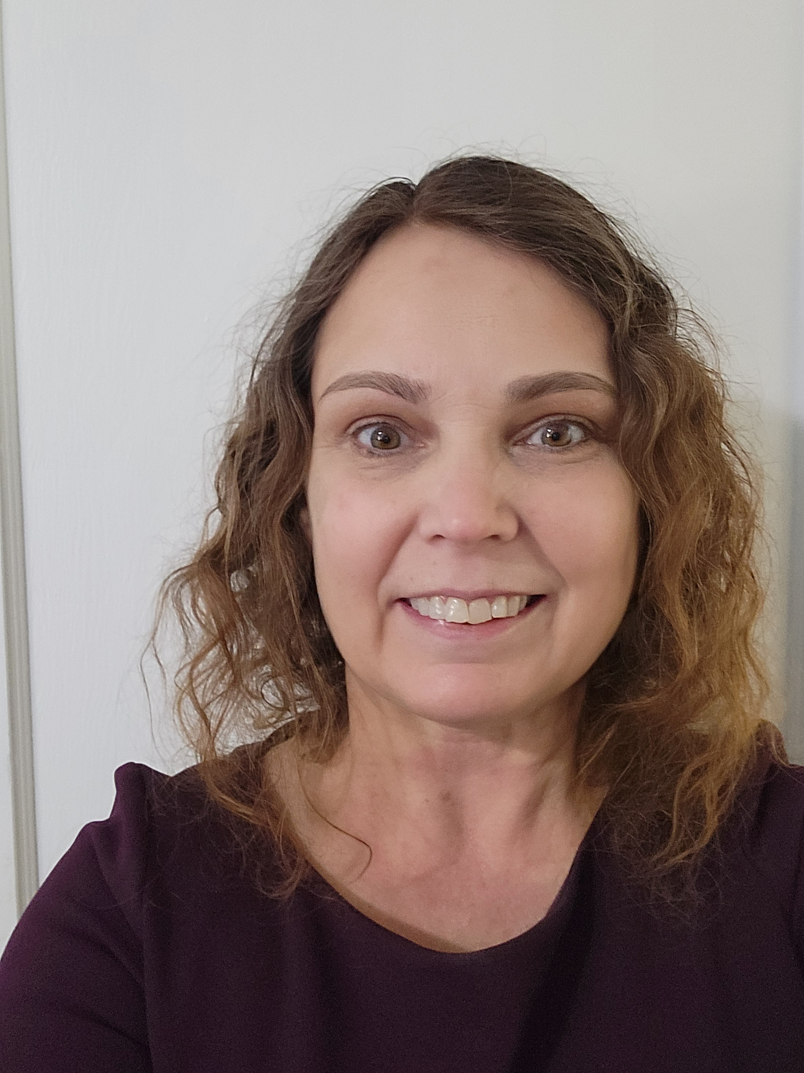
Professional in-home and telehealth breastfeeding support for moms and babies
Lactation Home About Me Services FAQs Insurance Contact
Success,
LLC
by Carolyn Mosier
APRN, IBCLC, RLC
Call me for an appointment
(703)599-9180

Slide 2
About me
My name is Carolyn Mosier. I am an International Board Certified Lactation Consultant an RN and an Advanced Practice Nurse. I am the mother to four wonderful breastfed children who are starting families of their own. My husband and I understand the challenges of busy working active duty families as we both served in the United State Navy.
I worked for many years as a NICU nurse assisting breastfeeding mothers. More recently I have worked as a lactation consultant providing breastfeeding support to mothers prenatally, on labor and delivery, postpartum and in outpatient settings.
It is a privilege to share my experience and expertise with mothers all along their breastfeeding journey. My approach to breastfeeding is meeting mothers and babies where they are and capitalizing on strategies and techniques to maximize their success. My aim is to understand mothers’ goals, address their concerns and support them along their breastfeeding journey.

Slide 3
Services
.
Prenatal counseling and education to provide knowledge and confidence when baby arrives
Demonstration of basic position and latch of the infant
Breastfeeding the premature infant
Support and care plans for mothers with low milk supply
Improved breastfeeding, pumping and supplementation strategies for babies with slow weight gain
Latching techniques to avoid and mitigate sore nipples
Assessment of baby with ankyloglossia (tongue tie) and referral as needed
Methods that ease engorgement
Importance of paced bottle feeds when introduced
Education on the signs and symptoms of mastitis, therapies and when to see your primary care provider
Dealing with plugged ducts
Breastfeeding multiples
Breastfeeding the baby with jaundice
Returning to work

Slide 4
FAQs
How do I make an appointment?
Call or text me at (703)500-9180. Alternatively, click the link below to make your appointment through The Lactation Network.
Where do you see clients for appointments?
I see mothers and babies in their homes and virtually via telehealth appointments.
What area do you cover?
I currently cover a 25 mile radius from Falls Church, Virginia.
Do you charge for travel?
No, I do not.
How should I prepare for the appointment?
Do you take insurance?
Yes, I work with The Lactation Network who process insurance inquiries for lactation consultants. Click on this link for more information and to see if your insurance is covered.
How should I prepare for the appointment?
Try to time baby’s feeding so that he or she is hungry at the appointment time. I’ll want to assess a feed and offer advice. Prepare any questions you may have so I can address any issues. Feel free to have a support person be part of the consultation. Please be sure that any dogs are away during the appointment.

Slide 5
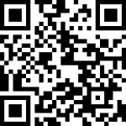
Insurance
I have partnered with The Lactation Network (TLN) and offer lactation services covered by many insurance companies. Click on the link below to register and see if your insurance is covered.
Once approved through TLN, 100% of unlimited lactation visits will be covered as needed through your insurance company.
TLN covers many PPO plans.
Anthem
most Blue Cross Blue Shield (not Federal)
Veterans Affairs Community Care Network (VA CCN) through Optum Care in Regions 1, 2 and 3, Multiplan
United
I have applied to become a Tricare provider and
hope to see those clients in the near future.
https://go.lactationnetwork.com/LactationSuccessLLC

